Slide 1
Ad It Up !
- Viginesh Sankararaman

Slide 2
Problem Statement
Mimicking web-based advertising model.
Auction based advertising system.
Offering ad space to highest bidder.
Dynamic displaying of ad

Slide 3
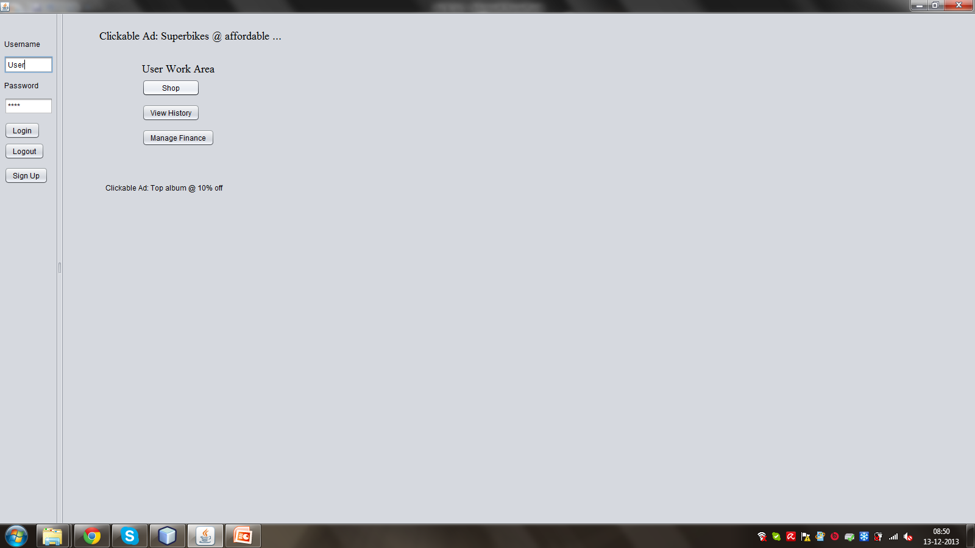
Features Included
Ads are dynamically selected and at the moment of click.
The ad space is assigned to the highest bidder.

Slide 4
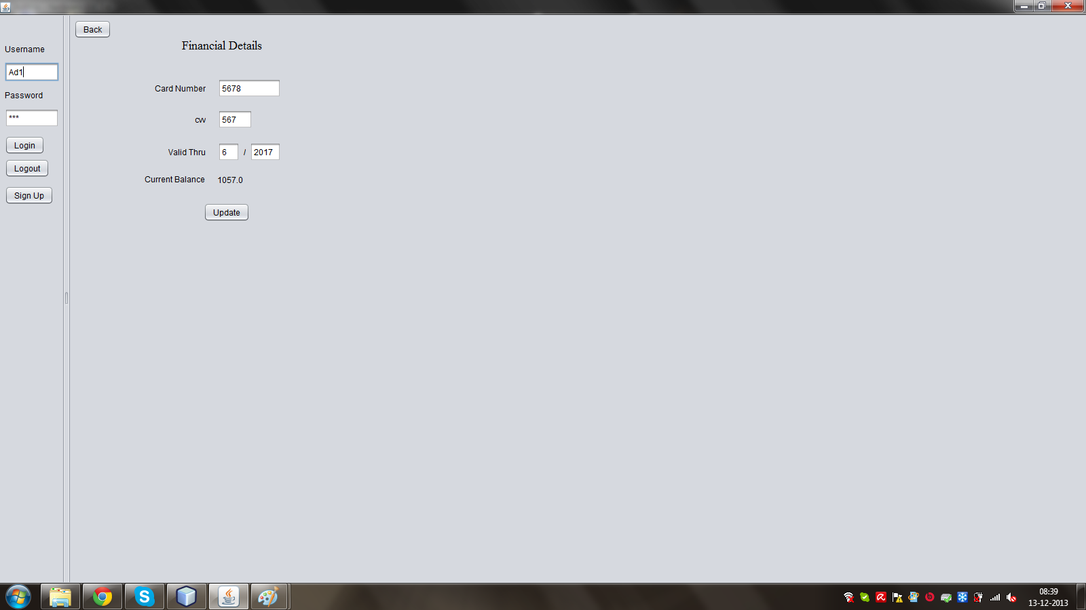
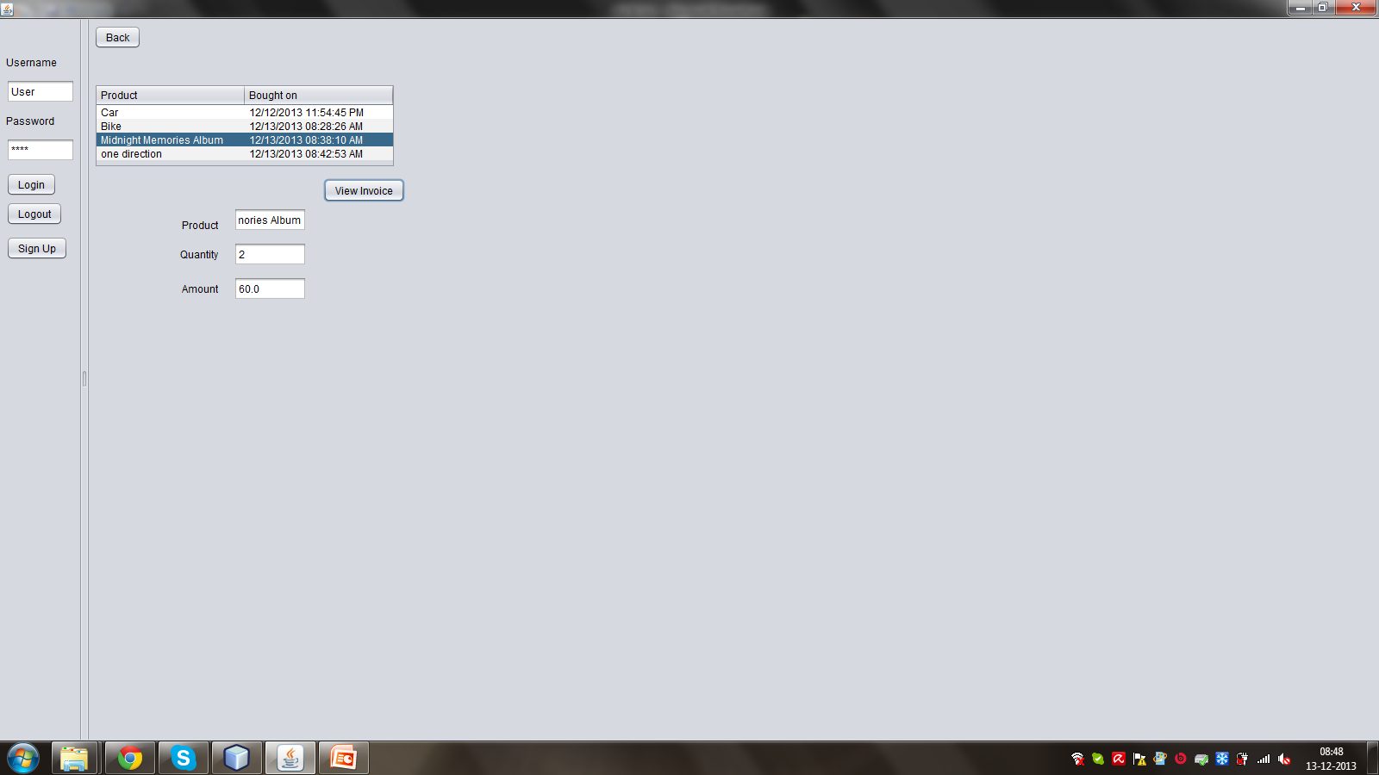
Features Included
Invoicing and payment are supported.

Slide 5
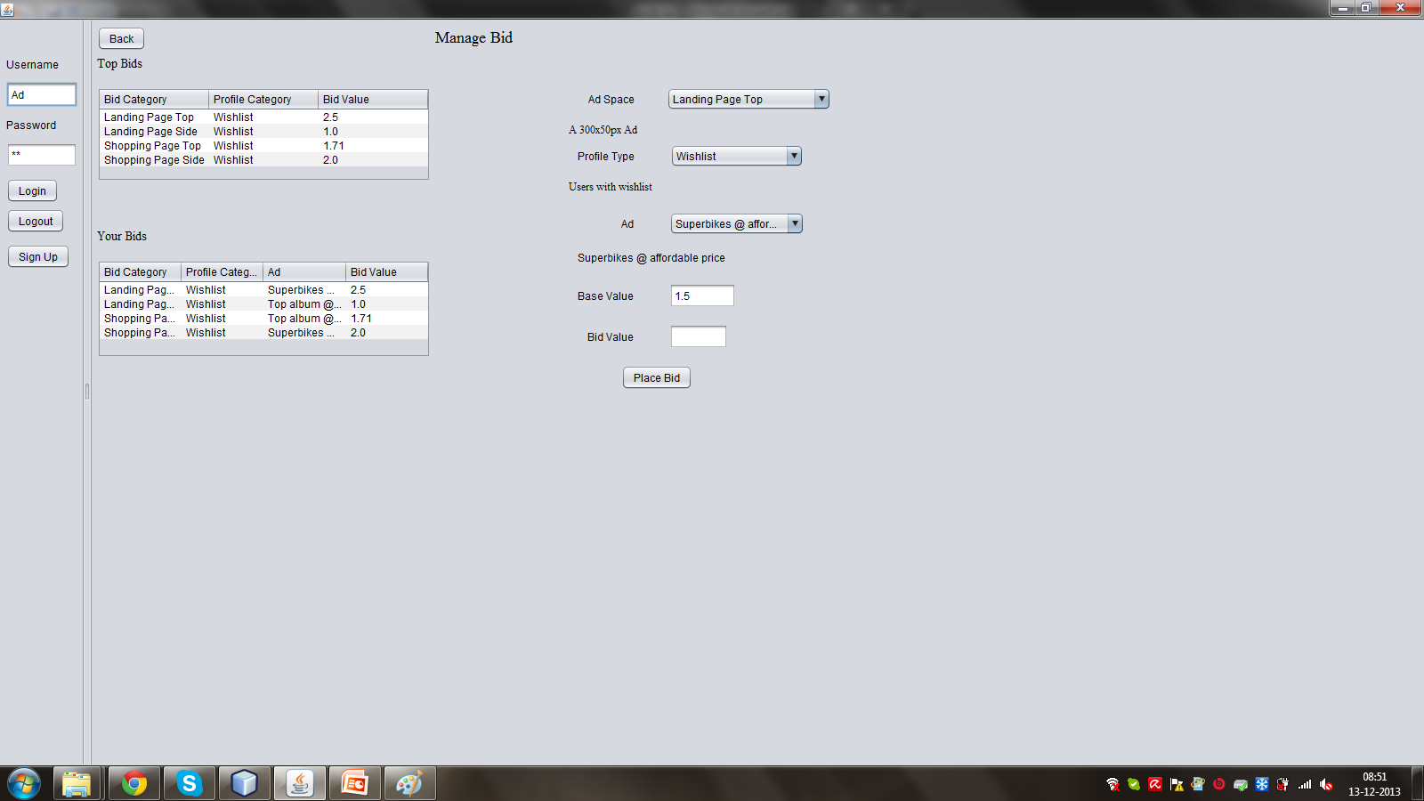
Features Included(Continued)
Auction like model where user profiles and habits are offered to potential advertisers

Slide 6
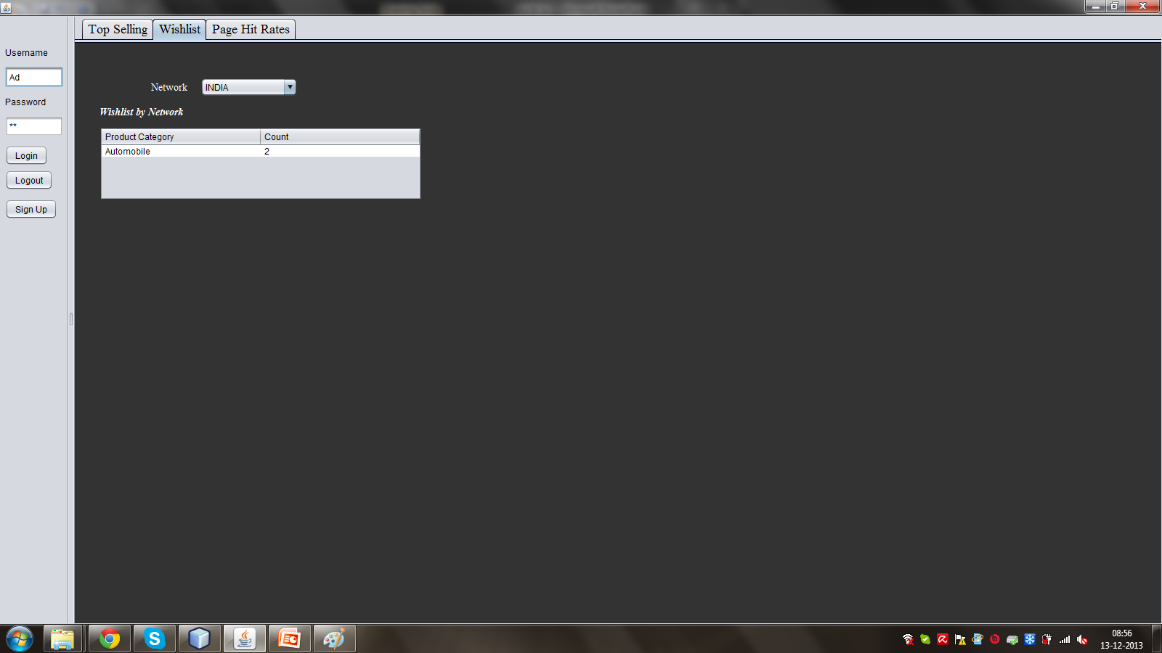
Features Included(Continued)
The system maintains a detailer profile of user.

Slide 7
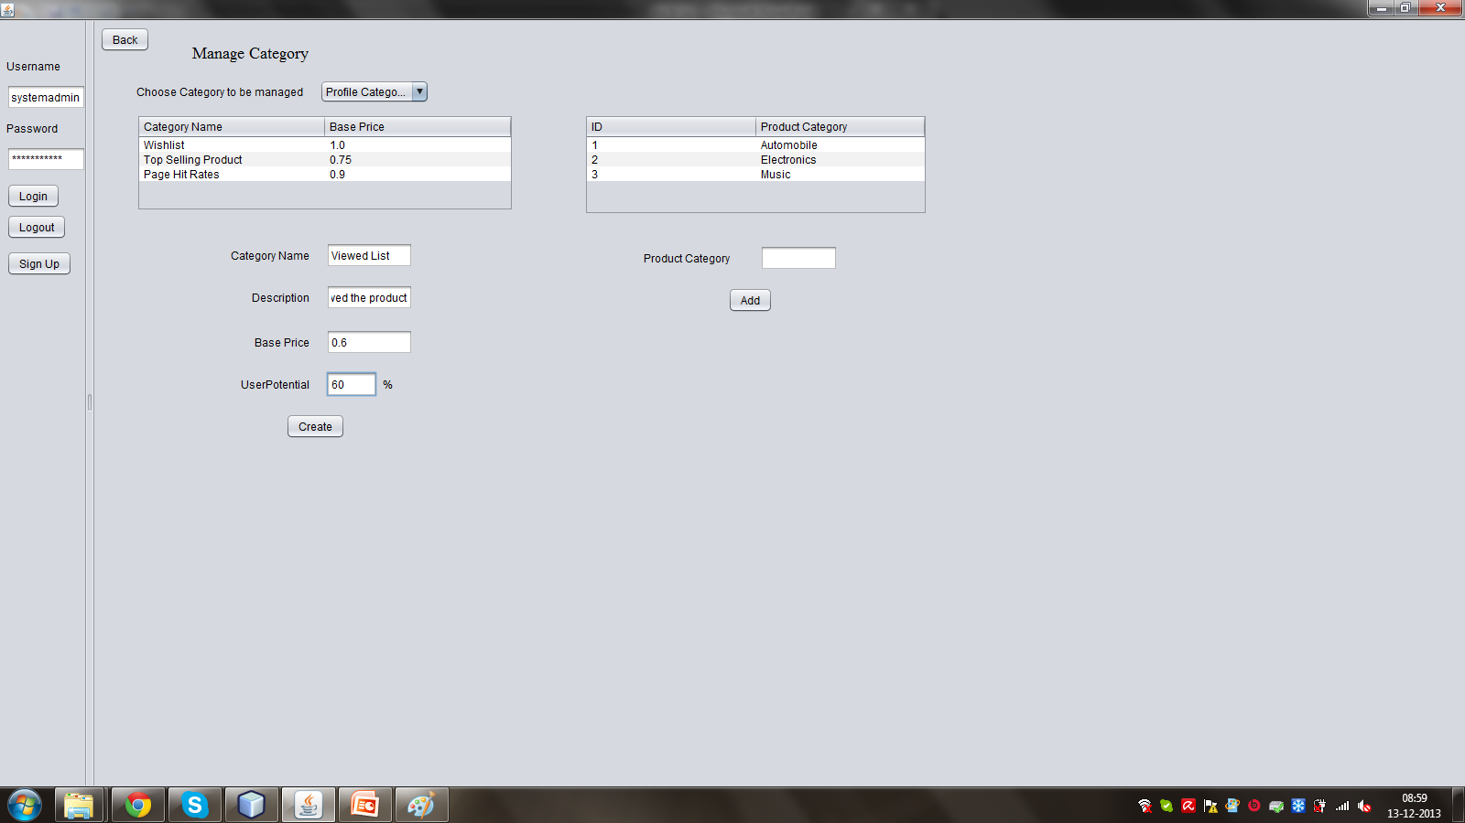
Features Included(Continued)
Market definition and classification of users based on certain characteristics
Ad price is determined on a multitude of factors.

Slide 8
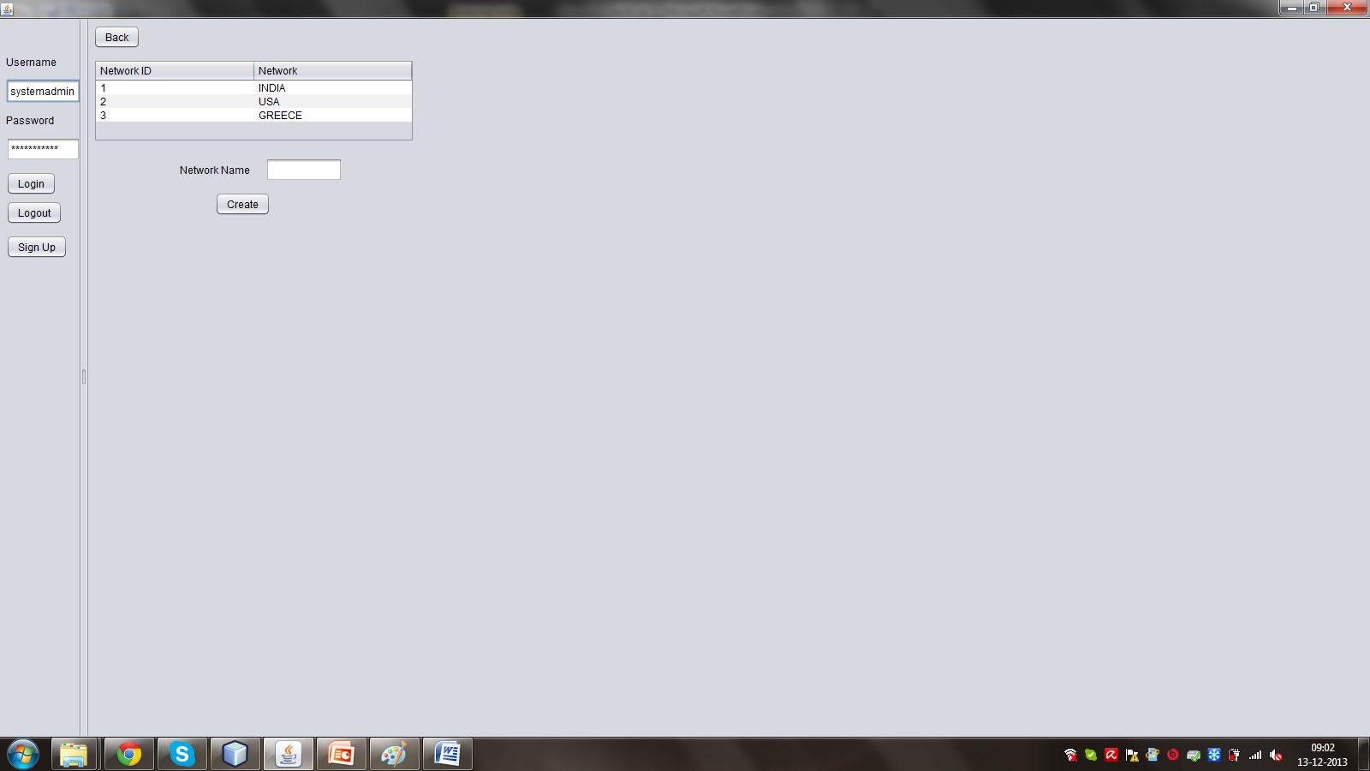
Features Included(Continued)
The system is global in nature and geography aware.

Slide 9
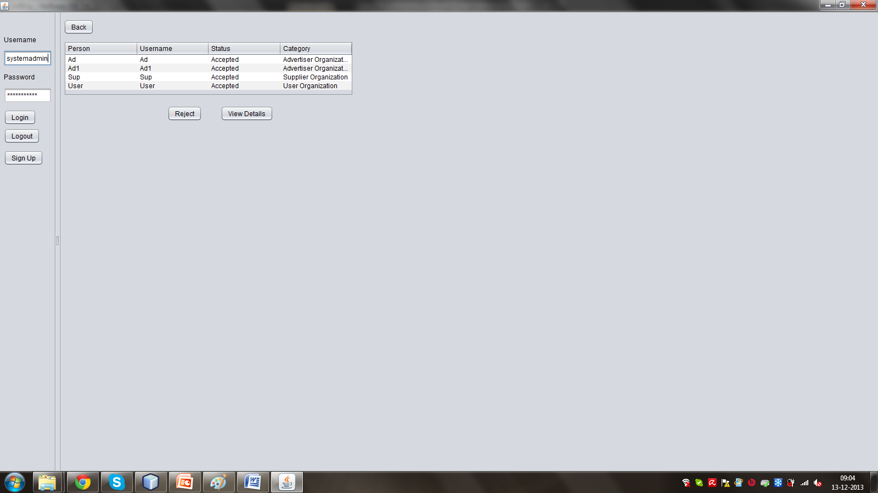
Features Included(Continued)
The system includes companies who wish to advertise as well as advertising and marketing agencies

Slide 10
Users Of The System
System Admin :
Manages Network and their organizations.
Manages User Account.
Manages Categories and Auction.
Advertisers:
Manages ads.
Bids ad for various ad spaces
Suppliers:
Manages products.
User:
Buys products

Slide 11
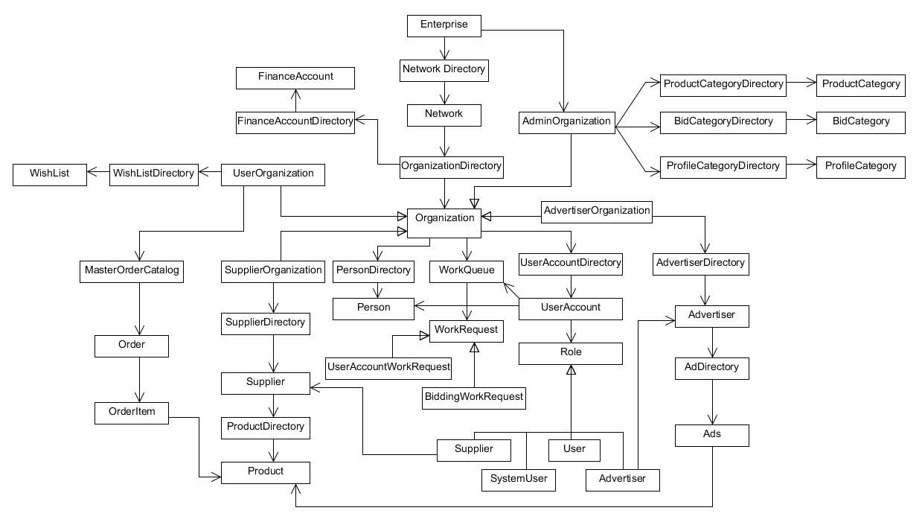
Object Model

Slide 12
Architecture
Database (DB4O)
Java Libraries
(JDK 1.7)
Swing Interface
Swing Interface
DB4O JAR
Swing Interface

Slide 13
Demo
Display Project

Slide 14
Summary
A swing-based java project mimicking internet advertising.
Ads are displayed in user panels.
Ads are obtained dynamically.
On click, user is taken to the ad’s product which he can buy.

Slide 15
Thank You!

